Slide 1
NAAN MUDHALVAN PROJECT
RAMYA S(2021503545)
3RD YEAR
COMPUTER TECHNOLOGY
MADRAS INSTITUTE OF TECHNOLOGY

Slide 2
TITLE Advancing Heart Disease Prediction: Neural Network Models for Accurate Diagnosis

Slide 3

AGENDA
PROBLEM STATEMENT
OBJECTIVES
NOVELTY
END USERS
SOLUTIONS AND PROPORTIONS
MODELLING
RESULTS

Slide 4
PROBLEM STATEMENT
Heart disease, a prevalent medical condition, involves various cardiovascular problems affecting the heart's functionality. Accurate diagnosis and timely intervention are important for effective management and prevention of adverse outcomes. The main aim of this project is to enhance heart disease diagnosis using neural network models, including feedforward neural networks and binary classification. Leveraging deep learning techniques, the project aims to improve diagnostic accuracy and enable early detection and intervention, ultimately leading to better patient outcomes in cardiovascular healthcare.

Slide 5
OBJECTIVES
To improve the accuracy and reliability of heart disease diagnosis by leveraging advanced predictive modeling capabilities provided by neural networks.
To develop neural network models, specifically feedforward neural networks, for accurate prediction of heart disease.
To utilize deep learning techniques to enhance the efficiency and precision of heart disease diagnosis.
To create neural network models capable of classifying the severity of heart disease based on a comprehensive dataset of medical attributes.
To develop a separate neural network model for binary classification to predict the presence or absence of heart disease.
To simplify the diagnostic process to a yes/no outcome, aiding in quick identification of individuals at risk and enabling timely intervention.

Slide 6
NOVELTY
Integration Of Binary Classification With Multi-class Classification:
Binary classification offers a streamlined approach to diagnosis, enabling healthcare professionals to quickly determine whether a patient is at risk of heart disease or not, based on the predictive model's output.
By simplifying the diagnostic process to a binary outcome, the model can facilitate rapid decision-making and intervention strategies, particularly in time-sensitive situations.
This approach enhances the interpretability and practicality of the predictive models, making them more accessible and user-friendly for healthcare professionals in diverse clinical settings.
Additionally, integrating binary classification alongside multi-class classification provides a comprehensive diagnostic framework, catering to different diagnostic needs and scenarios encountered in cardiovascular medicine.

Slide 7
END USERS
Healthcare Professionals: Cardiologists, general practitioners, and other medical professionals who utilize the predictive models as decision support tools for heart disease diagnosis and patient management.
Patients: Individuals seeking medical care for heart-related concerns, who benefit from accurate diagnosis and timely intervention facilitated by the predictive models.
Healthcare Institutions: Hospitals, clinics, and healthcare organizations that integrate the predictive models into their systems to improve the efficiency and effectiveness of heart disease diagnosis and treatment.
Healthcare Researchers: Scientists and researchers in the field of cardiovascular medicine who use the findings and methodologies of the project to advance knowledge and develop further innovations in heart disease diagnosis and management.

Slide 8
SOLUTION AND ITS PROPOSITION
SOLUTION:
The solution proposed in this project involves the development and evaluation of neural network models for heart disease prediction.
Leveraging deep learning techniques, specifically feedforward neural networks, the solution aims to enhance the accuracy and efficiency of heart disease diagnosis.
By analyzing patient data such as age, gender, blood pressure, and cholesterol levels, the models will be trained to accurately classify the severity of heart disease and determine its presence or absence.
Additionally, binary classification will be employed to simplify the diagnostic process to a yes/no outcome, aiding in quick identification of individuals at risk and enabling timely intervention.

Slide 9
SOLUTION AND ITS PROPOSITION
PROPOSITION
Data Acquisition and Preprocessing(10%):Acquiring and preprocessing the heart disease dataset to ensure data quality and suitability for model training.
Model Development(30%):Designing and developing neural network models, including both multi-class and binary classification architectures, tailored for heart disease prediction.
Training and Optimization(25%):Training the developed models using optimization techniques such as backpropagation and gradient descent, while fine-tuning hyperparameters to optimize model performance.
Evaluation and Analysis(25%):Evaluating the performance of the trained models using testing datasets and established metrics to assess their effectiveness.
Contribution to Healthcare Advancement(10%):Contributing to the advancement of predictive analytics in healthcare by enabling early detection and intervention for cardiovascular diseases, ultimately leading to improved patient outcomes and enhanced efficiency in heart disease diagnosis.

Slide 10
MODELLING
Data Acquisition:
The dataset containing information related to heart disease is obtained from the UCI Machine Learning Repository.
Data Preprocessing:
The dataset is loaded into a Pandas DataFrame.
Missing values, indicated by '?', are removed from the dataset.
Data Exploration:
Data characteristics such as shape, data types, and summary statistics are examined.
Histograms for each variable are plotted to visualize the distribution of data.
Data Preparation:
The dataset is divided into input features (X) and target labels (y).
The target labels are converted into categorical format using one-hot encoding.

Slide 11
MODELLING
Model Development:
Two neural network models are defined using Keras Sequential API.
The first model is designed for multi-class classification with three output neurons corresponding to different classes of heart disease.
The second model is created for binary classification to predict the presence or absence of heart disease.
Model Training:
Both models are compiled with appropriate loss functions, optimizers, and evaluation metrics.
The models are trained on the training data using the fit() function, specifying the number of epochs and batch size.
Model Evaluation:
The performance of the trained models is evaluated using the testing dataset.
Classification reports and accuracy scores are generated to assess the models' performance on both categorical and binary classification tasks.
Results Analysis:
The results obtained from the trained models are analyzed to understand their effectiveness in predicting heart disease.
Insights from the evaluation metrics are used to draw conclusions and identify areas for improvement.

Slide 12
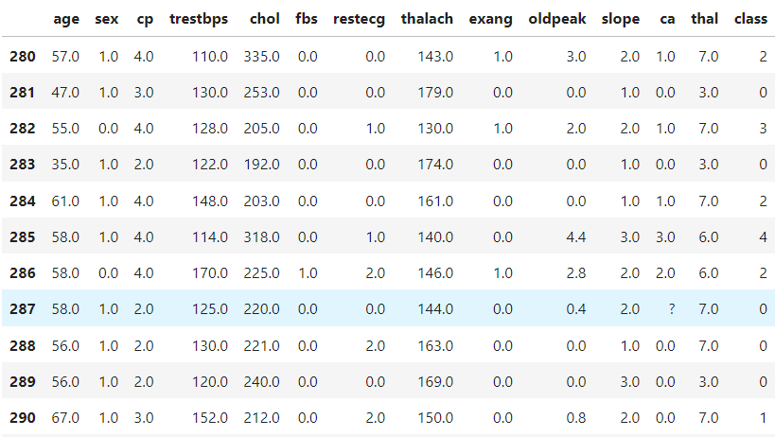
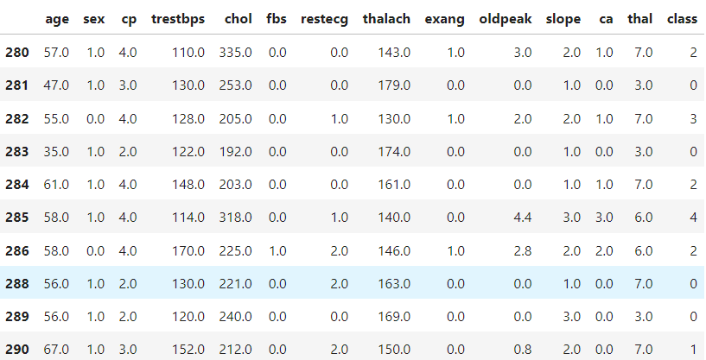
RESULTS
Dataset: Pre-processed Data:

Slide 13
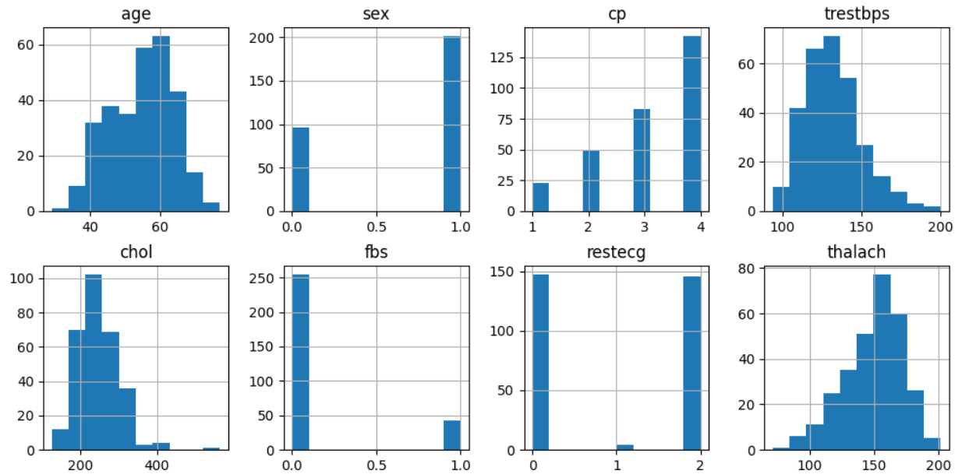
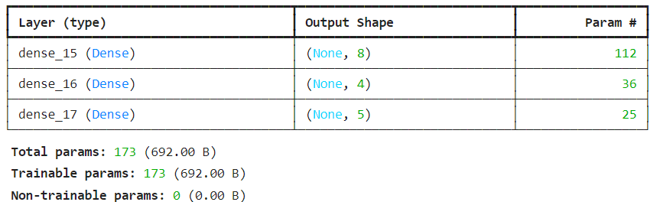
RESULTS
Dataset visualization: Feedforward Model:

Slide 14
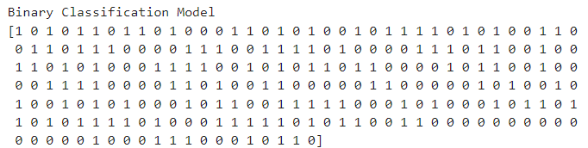
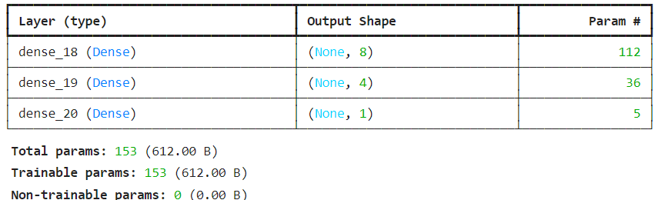
RESULTS
Binary Classification Model:

Slide 15
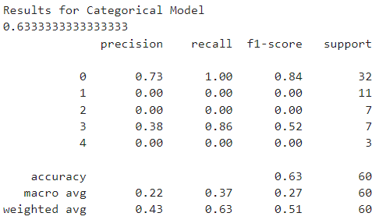
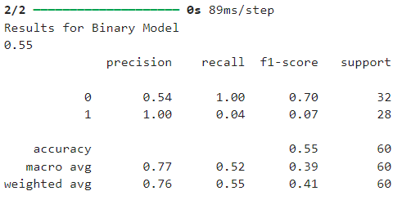
RESULTS
Evaluation:

Slide 16
REFERENCES
D. Swain, S. K. Pani and D. Swain, "A Metaphoric Investigation on Prediction of Heart Disease using Machine Learning," 2018 International Conference on Advanced Computation and Telecommunication (ICACAT), Bhopal, India, 2018, pp. 1-6, doi: 10.1109/ICACAT.2018.8933603.
G. Singh, K. Guleria and S. Sharma, "Machine Learning and Deep Learning Models for Early Detection of Heart Disease," 2023 International Conference on Computing, Communication, and Intelligent Systems (ICCCIS), Greater Noida, India, 2023, pp. 419-424, doi: 10.1109/ICCCIS60361.2023.10425392.
G. Shanmugasundaram, V. M. Selvam, R. Saravanan and S. Balaji, "An Investigation of Heart Disease Prediction Techniques," 2018 IEEE International Conference on System, Computation, Automation and Networking (ICSCA), Pondicherry, India, 2018, pp. 1-6, doi: 10.1109/ICSCAN.2018.8541165.
J. Singh, A. Kamra and H. Singh, "Prediction of heart diseases using associative classification," 2016 5th International Conference on Wireless Networks and Embedded Systems (WECON), Rajpura, India, 2016, pp. 1-7, doi: 10.1109/WECON.2016.7993480.
P. S. Sangle, R. M. Goudar and A. N. Bhute, "Methodologies and Techniques for Heart Disease Classification and Prediction," 2020 11th International Conference on Computing, Communication and Networking Technologies (ICCCNT), Kharagpur, India, 2020, pp. 1-6, doi: 10.1109/ICCCNT49239.2020.9225673.

Slide 17
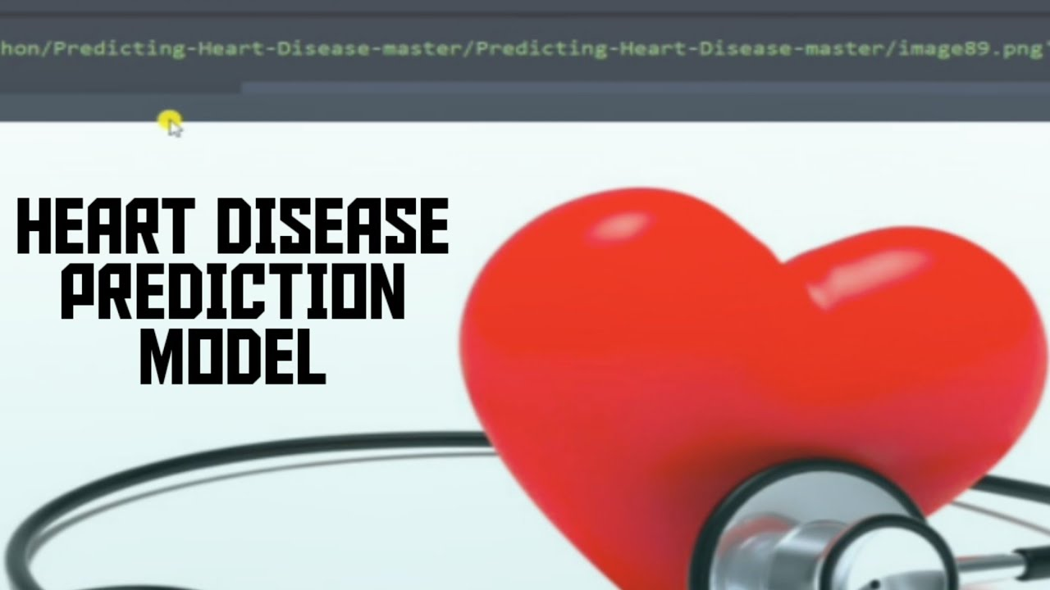
THANK YOU

